Slide 1
Coreference Resolution
Zhao Yilong

Slide 2
Outline
Background
Problem Definition
History
Applications
Three Milestones for Supervised Learning
Mention-Pair Model
Entity-Mention Model
Mention-Ranking Model
State-of-the-Art Methods

Slide 3
Outline
Background
Problem Definition
History
Applications
Three Milestones for Supervised Learning
Mention-Pair Model
Entity-Mention Model
Mention-Ranking Model
State-of-the-Art Methods

Slide 4
Problem Definition
Input
Documents
With NPs(Noun Phrases/Mentions) already identified by human or by other NLP tools
Output
Set of NPs that are referring to the same real-world entity in this particular context

Slide 5
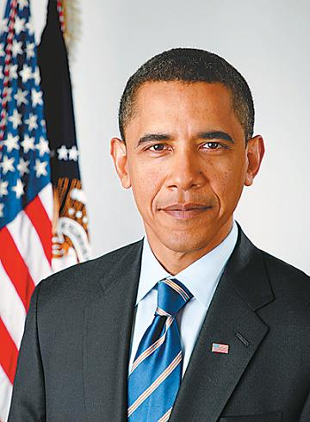
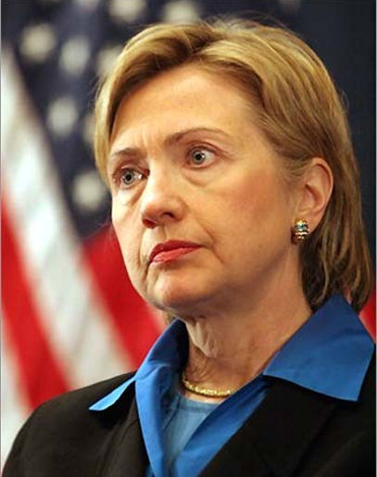
Problem Definition
Barack Obama nominated Hillary Rodham Clinton as his secretary of state on Monday. He chose Clinton because she had foreign affair experience as a former First Lady.
{Barack Obama, his, He}
{Hillary Rodham Clinton, secretary of state, Clinton, she, First Lady}

Slide 6
Outline
Background
Problem Definition
History
Applications
Three Milestones for Supervised Learning
Mention-Pair Model
Entity-Mention Model
Mention-Ranking Model
State-of-the-Art Methods

Slide 7
History
Before 1990s
Heuristic Rules, Grammar Rules
1990 ~ Present
Supervised Learning Methods
Mention-Pair, Entity-Mention, Mention-Ranking
External Knowledge Sources
WordNet, FrameNet, YAGO
Unsupervised Learning Methods
Multi-Pass Sieve

Slide 8
Outline
Background
Problem Definition
History
Applications
Three Milestones for Supervised Learning
Mention-Pair Model
Entity-Mention Model
Mention-Ranking Model
State-of-the-Art Methods

Slide 9
Applications
Supporting tool for many NLP tasks that focus on entities
Relation Extraction
Name-Entity Recognition
Building block for all NLP tasks that handle text beyond sentence-level
Question Answering
Text Summarization

Slide 10
Outline
Background
Problem Definition
History
Applications
Three Milestones for Supervised Learning
Mention-Pair Model
Entity-Mention Model
Mention-Ranking Model
State-of-the-Art Methods

Slide 11
Mention-Pair Model
1. Enumerate over all possible NP pairs in the document and label them as training examples
2. Use an appropriate learning algorithm to learn a classification model for NP pairs
3. Use an clustering algorithm to merge the coreferent pairs into clusters

Slide 12
Mention-Pair Model
Barack Obama nominated Hillary Rodham Clinton as his secretary of state on Monday. He chose Clinton because she had foreign affair experience as a former First Lady.
Training Examples
Positive Examples
(blue, blue) (red, red)
Negative Examples
(blue, red) (red, blue)

Slide 13
Mention-Pair Model
Possible Features in the Classification Model
String-Matching Features
Exact/Substring matching
(Hillary Rodham Clinton, Clinton)
Prefix/Suffix matching
Head noun matching
POS-Tags
Semantic Class

Slide 14
Mention-Pair Model
Possible Features in the Classification Model
Agreement Features
Gender agreement
(First Lady, He)
Number agreement
Distance
Closer NPs tend to be coreferent

Slide 15
Mention-Pair Model
Merge Coreferent Pairs into Clusters
A Straightforward Approach
Closest-First Clustering
Pick the closest antecedent
Best-First Clustering
Pick the best antecedent
Train another clustering model
Bad idea

Slide 16
Mention-Pair Model
Weakness
Unbalanced training data
Given N NPs, we generate N^2 training examples, most of which are negative examples
Modeling based on pairs is inherently a bad choice
Classification process treat NP pairs independently
(Mr. Clinton, Clinton) (Clinton, She) (Mr. Clinton, She)
Limited Expressiveness
Most features limited to individual NPs themselves

Slide 17
Outline
Background
Problem Definition
History
Applications
Three Milestones for Supervised Learning
Mention-Pair Model
Entity-Mention Model
Mention-Ranking Model
State-of-the-Art Methods

Slide 18
Entity-Mention Model
Instead of focusing on “pairs”, we focus on entity(cluster), possibly partially formed ones
Barack Obama nominated Hillary Rodham Clinton as his secretary of state on Monday. He chose Clinton because she had foreign affair experience as a former First Lady.
({Barack Obama , his}, He)
({Hillary Rodham Clinton, secretary of state, Clinton}, she)

Slide 19
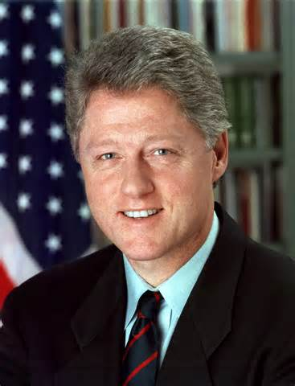
Entity-Mention Model
Improvement
More training examples
Mention-Pair model have at most N^2 examples
Better Features
0/1 features -> real-valued features
Classification decisions have dependencies between each other
(Mr. Clinton, Clinton) (Clinton, She) (Mr. Clinton, She)
({Mr. Clinton}, Clinton) ({Mr. Clinton, Clinton}, She)

Slide 20
Entity-Mention Model
Weakness
Training data even more unbalanced
Introduce an ordered process
The classification process is not fair
NPs in early-formed clusters gain a natural advantage
Sounds great, but simply doesn’t work
Little real performance improvement

Slide 21
Performance Metrics

Slide 22
Outline
Background
Problem Definition
History
Applications
Three Milestones for Supervised Learning
Mention-Pair Model
Entity-Mention Model
Mention-Ranking Model
State-of-the-Art Methods

Slide 23
Mention-Ranking Model
Instead of a classification problem, we treat Coreference Resolution as a ranking problem
Barack Obama nominated Hillary Rodham Clinton as his secretary of state on Monday. He chose Clinton because she had foreign affair experience as a former First Lady.
(Barack Obama, He, she)
(Hillary Rodham Clinton, Clinton, First Lady)

Slide 24
Mention-Ranking Model
Use algorithms such as Ranking-SVM to learn a ranking model
Given an target NP, choose the candidate that is ranked as the better choice the largest number of times
Weakness
Modeling based on pairs
What if there are some NPs that refer to nothing in the context at all

Slide 25
Outline
Background
Problem Definition
History
Applications
Three Milestones for Supervised Learning
Mention-Pair Model
Entity-Mention Model
Mention-Ranking Model
State-of-the-Art Methods

Slide 26
Multi-Pass Sieve Motivation
Supervised Learning has little potential left for further improvements
Rich set of features
Different kinds of representations for tanning examples
All kinds of complex syntactic/semantic information incorporated

Slide 27
A Realistic Example
The second attack occurred after some rocket firings aimed, apparently, toward [the Israelis], apparently in retaliation. [We]’re checking our facts on that one. ... The president, quoted by Ari Fleischer, his spokesman, is saying he’s concerned the strike will undermine efforts by Palestinian authorities to bring an end to terrorist attacks and does not contribute to the security of [Israel].

Slide 28
Multi-Pass Sieve
Consists of multiple layers of sieve
Each pass represents a deterministic model that only select the best candidate at each pass given information from previous passes
Passes are applied in decreasing order of precision
Some features are global information that are shared across passes

Slide 29
Pass-1 & Pass-2
Pass-1(Exact Match)
Exact Match
Pass-2(Precise Constructs)
Appositive
Our mentor, Kenny, said that…
[President] [Obama]…, [Professor] [Kenny]…
Acronym
(WTO, World Trade Organization)

Slide 30
Pass-1 & Pass-2
Pass-2(Precise Constructs)
Demonym
(Israel, Israeli)
Relative Pronoun
the finance street [which] has already formed in the Waitan district…
Predicate Nominative
[The New York-based College Board] is [a nonprofit organization that administers the SATs and promotes higher education]

Slide 31
Pass-3
Pass-3(Strict Head Matching)
Cluster Head Match
Head word match any head word in a previous cluster
Word Inclusion
. . . intervene in the [Florida Supreme Court]’s move . . . does look like very dramatic change made by [the Florida court] point to . . .
Compatible Modifiers
Only work for a particular pair

Slide 32
Pass-4 & Pass-5
Both are built upon Pass-3
Pass-4(Variants of Strict Head)
Removes the Compatible modifiers constraint
Pass-5(Variants of Strict Head)
Removes the Word Inclusion constraint

Slide 33
Pass-6
Pass-6(Relaxed Head Matching)
Relax the head word to take some noun modifiers into account
Pass-7(Pronouns)
Number
Gender
Person

Slide 34
Global Information
Number Agreement
Gender Agreement
Certain Semantic Information
NER output
Animate or no

Slide 35
Performance Metrics

Slide 36
Multi-Pass Sieve
Improvements
Overcome all the problems caused by the training data
Has a flexible structure
We can plug in a new deterministic model very easily
They extend this model in 2011 with 4 more passes
Harness the fruits from Supervised Learning methods
They tell them which features are the best

Slide 37
Multi-Pass Sieve
Weakness
Not straightforward
Many subtleties in the underlying details
Involves too much fine-tuning
Order of the passes
Model selection

Slide 38
Q & A

Slide 39
Thank You
Have A Nice Day

